Slide 1
Track my Project
CSE 687 – object-oriented design
Instructor: Edmund Yu
Kiran Kumar Veparala [Team Lead]
Pavan Kumar Vaddineni
Sai Srinidhi Kanchi
Devendar Sai Thallam
Chaitanya Mandava

Slide 2
Introduction
The world is becoming more and more agile by the day with the introduction of practices such as Scrum, Kanban and Extreme programming.
With the software companies becoming more decentralized and us working in different time zones it gets difficult to coordinate with everyone individually.
One of the major problems we face with respect to software development is how to coordinate among the different team members.
With so many people working simultaneously on the same application keeping track of who does what and what is the status of each task is very important.

Slide 3
What are we trying to do?
We are trying to create an application which will make the coordination among different people seamless.
We want people to know who is working on what and when it might get completed so that we can take care of all the dependencies on time without facing any impediments.
Central repository which will keep track of all the pending and completed tasks for coordination among team.

Slide 4

Introducing Track my project application
The application is a dashboard which will let us create a new project.
It will consist of a name, a short name and a short description of what we are trying to achieve in that project.
After creating the project, we should be able to edit, archive and un-archive the project.
We cannot delete the project (after a long discussion we decided to remove the delete functionality) mainly because if we allow deletion of the project, we will not be able to keep track of exactly how much time and effort has already been spent on the project.
After the main project is created, we will split the project into many small manageable tasks. Based on the scrum principle, the size of each task should not exceed more than 1 day duration. If a task is very big which will take more than a day, then it must be further divided into smaller tasks to accommodate the 1-day rule.

Slide 5
We can create tasks in the form of cards in the dashboard. Each task/card created will have the above features
Labels
Description
Milestone
Due Date
Assigned User

Slide 6
Four main categories of tasks
Open
Close
Backlog
Deferred

Slide 7

Operations on the Dashboard:
Select/Deselect cards
Change the status of cards
Move cards to archive
Move cards to backlog
Move cards to trash

Slide 8
Functional requirements
Progress Tracking
Board
Project
Status
Cards
Milestone
Imports/Exports
Graphical Representation
E-tickets

Slide 9
Non-functional requirements
Portability
Performance
Reliability
Serviceability

Slide 10
SRS
1. Login and profile management.
2. Projects are created and assigned a column.
3. Cards are the means to stay aware of the progress of the project. Each project has cards which include the amount of work assigned and the amount of work currently being worked on.
4. Filtering the contents using keywords and labels.
5. Searching date, milestones or specifics on different pages.
6. Users can insert dates and details of the projects inside the calendar tab.
7. Project statistics are shown in the project tab.
8. Import/Export are allowed and executed by the users to acquire important data or get a database onto the application.
9. Creating cards via email. Configuration is required and could also be disabled for certain reasons. Notifying users by email can be done by them as well.
10. Administrations are the only one who are allowed to add and edit users.
11. External Integrations can be done by the administrators using javascript.
12. Feedbacks and comments are shared with the team.
13. Access Control of the card menu in a board.

Slide 11
General Features to implement
CREATE_PROJECT
UPDATE_PROJECT
CREATE_BOARD
UPDATE_BOARD
CREATE_COLUMN
UPDATE_COLUMN
CREATE_CARD
UPDATE_CARD
UPDATE_CARD_POSITION
UPDATE_DESCRIPTION
UPDATE_ACTION_LIST
CREATE_ACTION_ITEM
DELETE_ACTION_ITEM
UNDO_DELETE_ACTION_ITEM
TOGGLE_ACTION_ITEM
UPDATE_ACTION_ITEM
MOVE_ACTION_ITEM
CREATE_FILE
UNDO_DELETE_FILE
ADD_LABEL_VALUE_TO_CARD
UPDATE_LABLE_VALUE
REMOVE_LABEL_VALUE
CREATE_COMMENT
UPDATE_COMMENT
DELETE_COMMENT
UNDO_ DELETE_COMMENT
CREATE_ACTION_LIST
DELETE_ACTION_LIST
UNDO_DELETE_ACTION_LIST
UPDATE_ACTION_LIST

Slide 12







System architecture
Backend
Frontend
Database

Slide 13
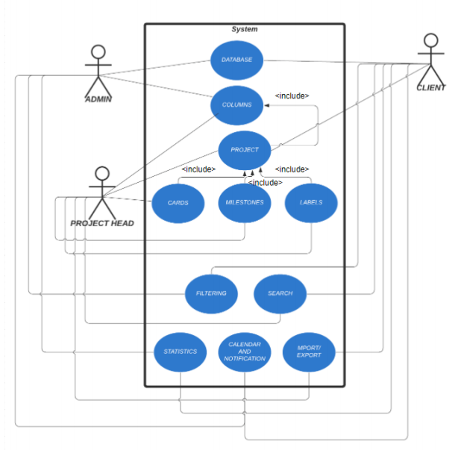
Use case diagram

Slide 14
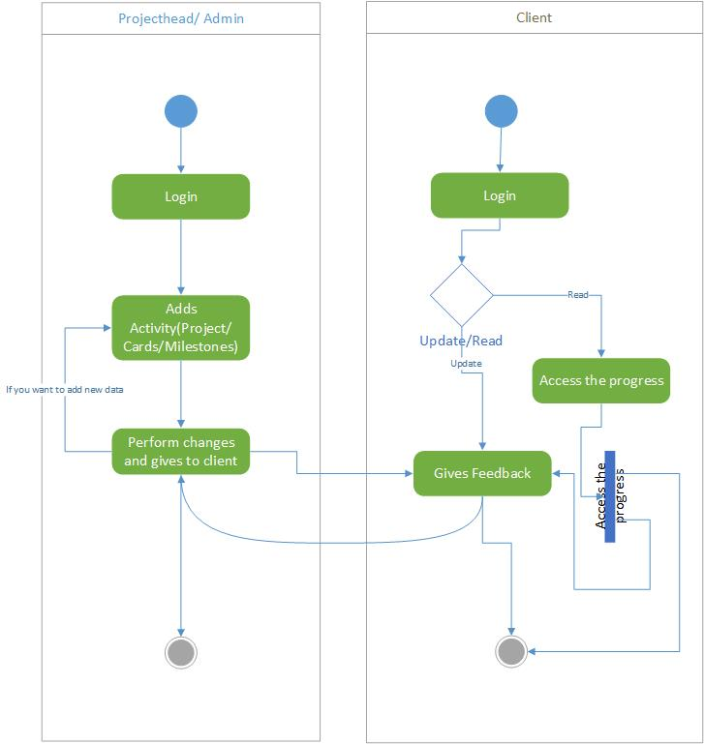
Activity diagram

Slide 15
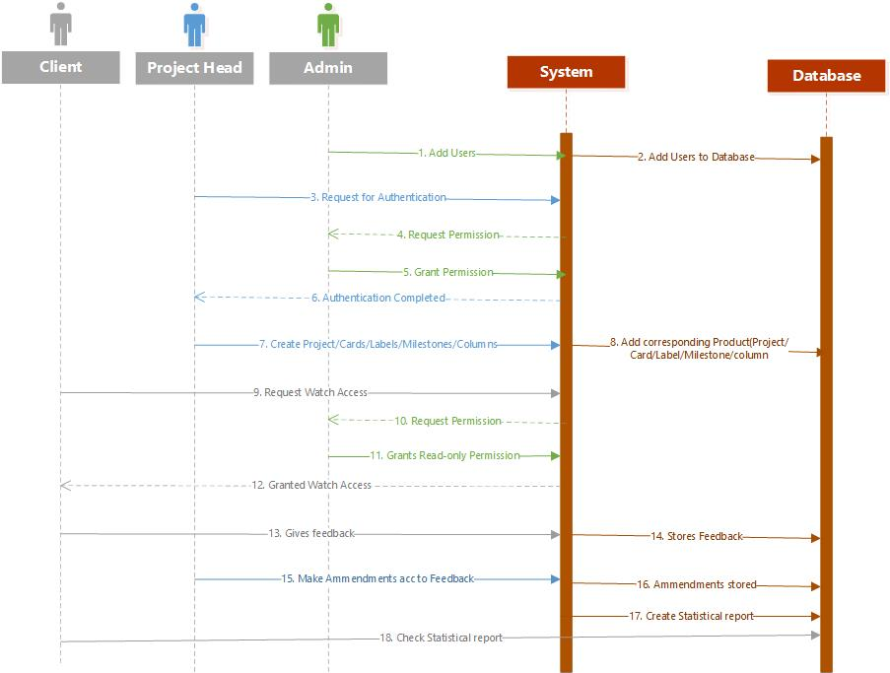
Sequence diagram

Slide 16
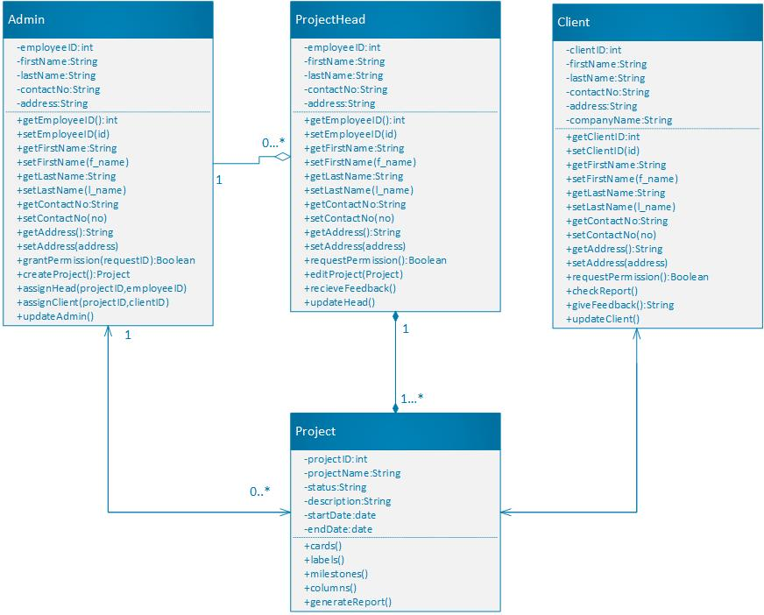
Class model

Slide 17
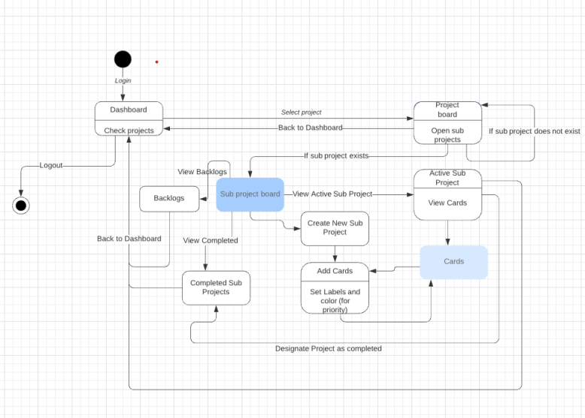
State diagram

Slide 18
Once the tasks/cards are created, we can do the following
Place the card in the respective columns
Clone the card
Change the due date of the card
Change title, Add description, Add labels
Add watchers to the assigned tasks

Slide 19

Thank you Q & A

